Slide 1

Natural Language Processing
Yue Zhang
Westlake University

Slide 2
Chapter 9
Sequence Segmentation

Slide 3
Contents
9.1 Sequence Segmentation
9.1.1 Evaluating Sequence Segmentation Outputs
9.1.2 Sequence Labelling Method for Sequence Segmentation
9.2 Discriminative Models for Sequence Segmentation
9.2.1 Word-Level Features for Word Segmentation
9.2.2 Exact Search Decoding Using Dynamic Program
9.2.3 Semi-Markov Conditional Random Fields
9.2.4 Large Margin Models
9.3 Perceptron and Beam Search
9.4 Summary

Slide 4
Contents
9.1 Sequence Segmentation
9.1.1 Evaluating Sequence Segmentation Outputs
9.1.2 Sequence Labelling Method for Sequence Segmentation
9.2 Discriminative Models for Sequence Segmentation
9.2.1 Word-Level Features for Word Segmentation
9.2.2 Exact Search Decoding Using Dynamic Program
9.2.3 Semi-Markov Conditional Random Fields
9.2.4 Large Margin Models
9.3 Perceptron and Beam Search
9.4 Summary

Slide 5
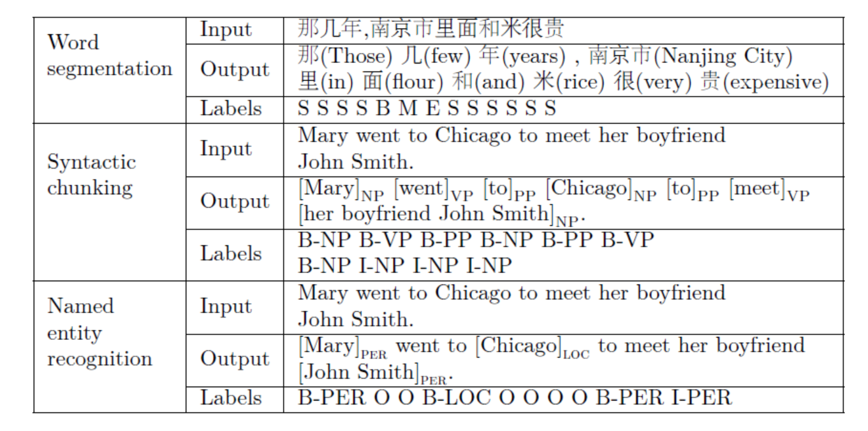
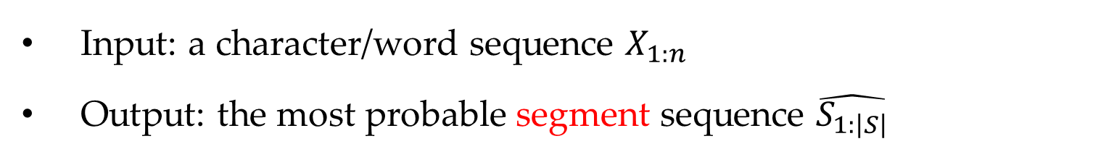
Sequence Segmentation Task
Input: a character/word sequence $X_{1:n}$
Output: the most probable segment sequence $\hat{S_{1:\left|S\right|}}$

Slide 6
Contents
9.1 Sequence Segmentation
9.1.1 Evaluating Sequence Segmentation Outputs
9.1.2 Sequence Labelling Method for Sequence Segmentation
9.2 Discriminative Models for Sequence Segmentation
9.2.1 Word-Level Features for Word Segmentation
9.2.2 Exact Search Decoding Using Dynamic Program
9.2.3 Semi-Markov Conditional Random Fields
9.2.4 Large Margin Models
9.3 Perceptron and Beam Search
9.4 Summary

Slide 7
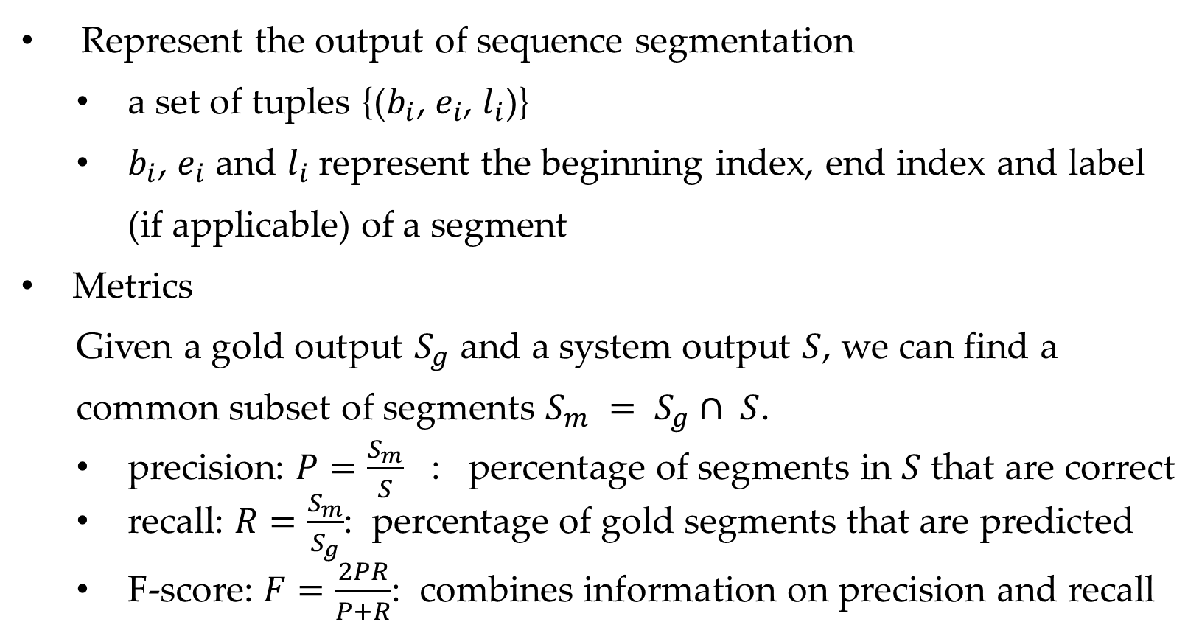
Evaluating sequence segmentation
Represent the output of sequence segmentation
a set of tuples {($b_{i}$, $e_{i}$, $l_{i}$)}
$b_{i}$, $e_{i}$ and $l_{i}$represent the beginning index, end index and label (if applicable) of a segment
Metrics
Given a gold output $S_{g}$ and a system output $S$, we can find a common subset of segments $S_{m} = S_{g}∩ S$.
precision: $P=\frac{S_{m}}{S}$ : percentage of segments in $S$ that are correct
recall: $R=\frac{S_{m}}{S_{g}}$: percentage of gold segments that are predicted
F-score: $F=\frac{2PR}{P+R}$: combines information on precision and recall

Slide 8
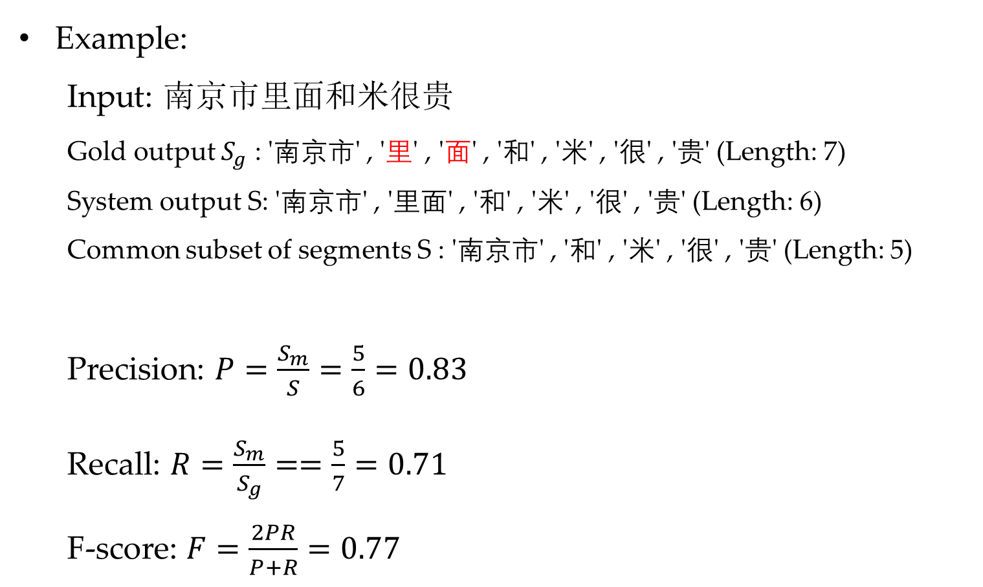
Evaluating sequence segmentation
Example:
Input: 南京市里面和米很贵
Gold output $S_{g}$ : '南京市' , '里' , '面' , '和' , '米' , '很' , '贵' (Length: 7)
System output S: '南京市' , '里面' , '和' , '米' , '很' , '贵' (Length: 6)
Common subset of segments S : '南京市' , '和' , '米' , '很' , '贵' (Length: 5)
Precision: $P=\frac{S_{m}}{S}=\frac{5}{6}=0.83$
Recall: $R=\frac{S_{m}}{S_{g}}==\frac{5}{7}=0.71$
F-score: $F=\frac{2PR}{P+R}=0.77$

Slide 9
Contents
9.1 Sequence Segmentation
9.1.1 Evaluating Sequence Segmentation Outputs
9.1.2 Sequence Labelling Method for Sequence Segmentation
9.2 Discriminative Models for Sequence Segmentation
9.2.1 Word-Level Features for Word Segmentation
9.2.2 Exact Search Decoding Using Dynamic Program
9.2.3 Semi-Markov Conditional Random Fields
9.2.4 Large Margin Models
9.3 Perceptron and Beam Search
9.4 Summary

Slide 10
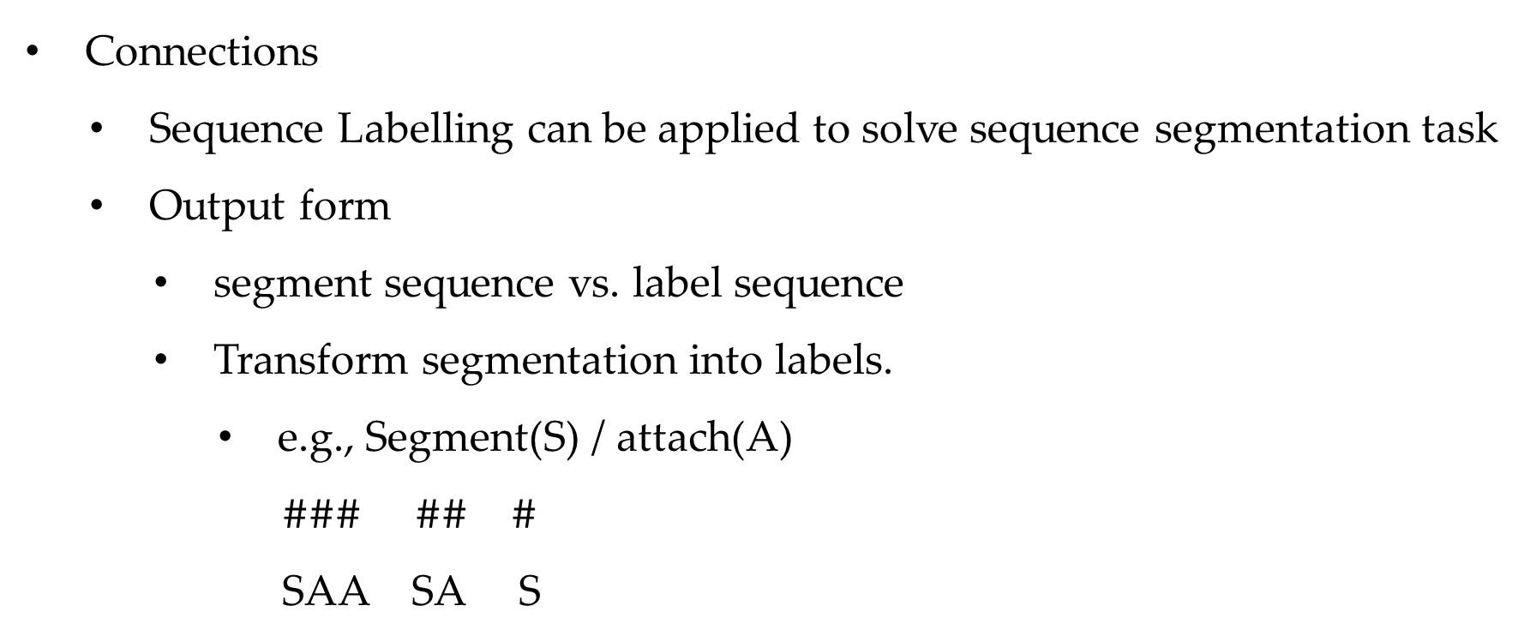
Segmentation vs Sequence Labelling
Connections
Sequence Labelling can be applied to solve sequence segmentation task
Output form
segment sequence vs. label sequence
Transform segmentation into labels.
e.g., Segment(S) / attach(A)
$\#\#\#$ $\#\#$ $\#$
SAA SA S

Slide 11
Segmentation vs Sequence Labelling
Sequence Labeling
Input: [我] [吃] [了] [苹果]
Output: 我(P) 吃(V) 了(U) 苹果(NN)
Sequence Segmentation
Input: [我] [吃] [了] [苹果]
Output: [我] [吃 了 苹果]
Labels: P V U NN
Labels: S B-VP I-VP I-VP
More fine grained tags.
Combine segmentation label with chunk type.

Slide 12
Typical label sets
Word segmentation
label: B (Beginning), I (Internal), E (Ending) and S (Single-character word)
Syntactic chunking
label: {B, I}
combine syntactic categories: such as B-VP or I-NP
Named entity recognition
label: {B-X, I,E, S-X,O}
X indicates the type of entity: PER (person), LOC (location), ORG (organization)
O: a non-named entity word

Slide 13
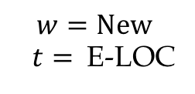
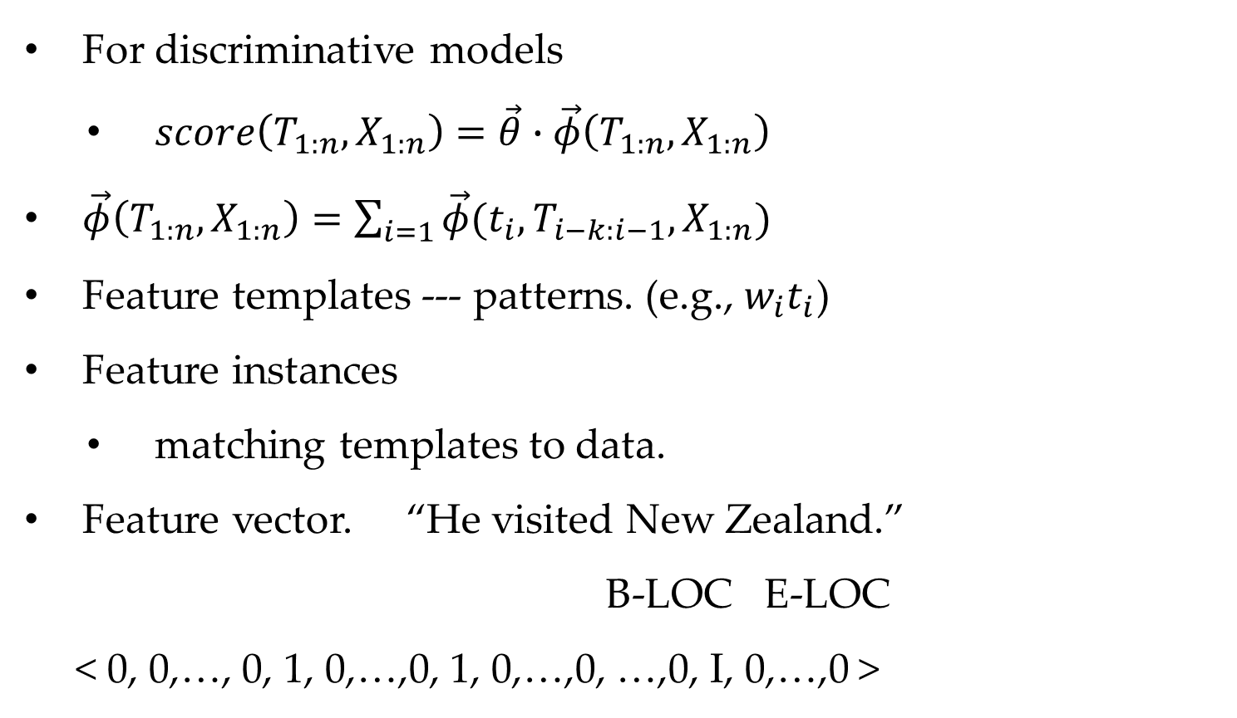
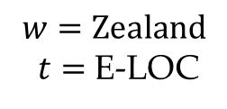
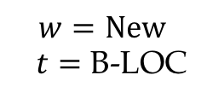
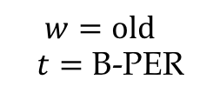
Features templates
For discriminative models
$score\left(T_{1:n},X_{1:n}\right)=\vec{θ}∙\vec{φ}\left(T_{1:n},X_{1:n}\right)$
$\vec{φ}\left(T_{1:n},X_{1:n}\right)=\sum_{i=1}{\vec{φ}(t_{i},T_{i−k:i−1},X_{1:n})}$
Feature templates --- patterns. (e.g., $w_{i}t_{i}$)
Feature instances
matching templates to data.
Feature vector. “He visited New Zealand.”
B-LOC E-LOC
< 0, 0,…, 0, 1, 0,…,0, 1, 0,…,0, …,0, I, 0,…,0 >
$$w=New$$
$t=$ E-LOC
$$w=New$$
$t=$ B-LOC
$$w=old$$
$t=$ B-PER
$$w=Zealand$$
$t=$ E-LOC

Slide 14
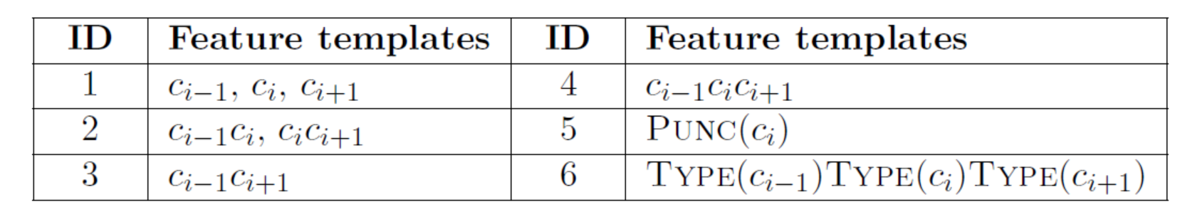
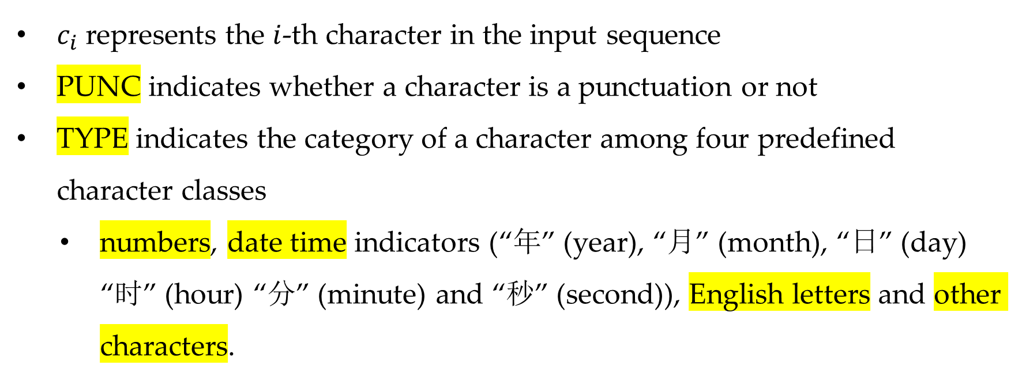
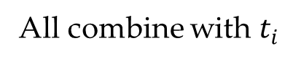
Features for word segmentation
All combine with $t_{i}$
$c_{i}$ represents the $i$-th character in the input sequence
PUNC indicates whether a character is a punctuation or not
TYPE indicates the category of a character among four predefined character classes
numbers, date time indicators (“年” (year), “月” (month), “日” (day) “时” (hour) “分” (minute) and “秒” (second)), English letters and other characters.

Slide 15
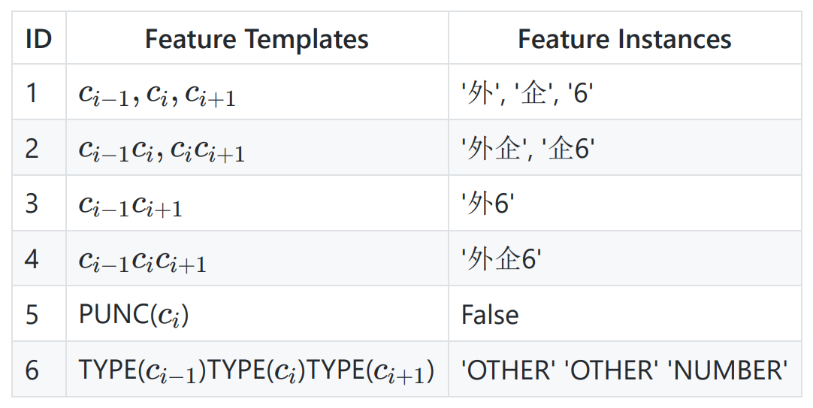
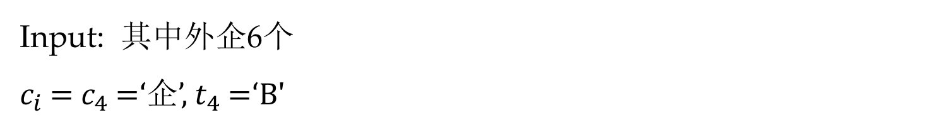
Example
Input: 其中外企6个
$c_{i}$ = $c_{4}$ =‘企’, $t_{4}$ =‘B'
All combine with “B”

Slide 16
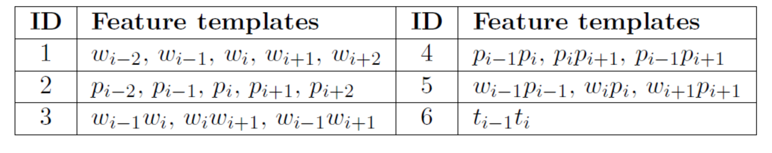
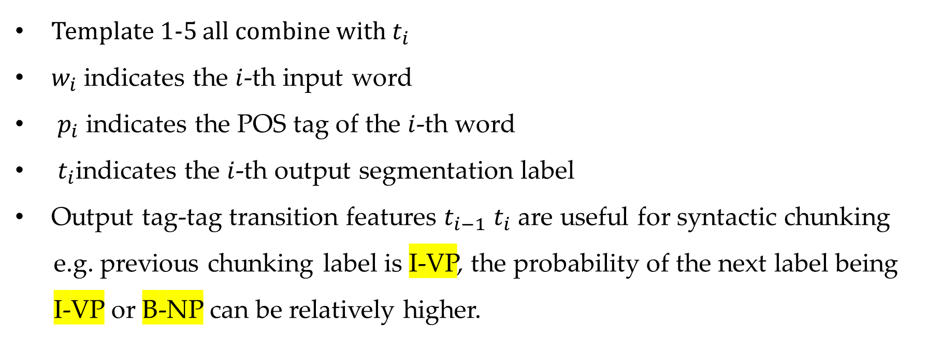
Features for syntactic chunking
Template 1-5 all combine with $t_{i}$
$w_{i}$ indicates the $i$-th input word
$p_{i}$ indicates the POS tag of the $i$-th word
$t_{i}$indicates the $i$-th output segmentation label
Output tag-tag transition features $t_{i−1}$ $t_{i}$ are useful for syntactic chunking
e.g. previous chunking label is I-VP, the probability of the next label being I-VP or B-NP can be relatively higher.
Notes:
notations

Slide 17
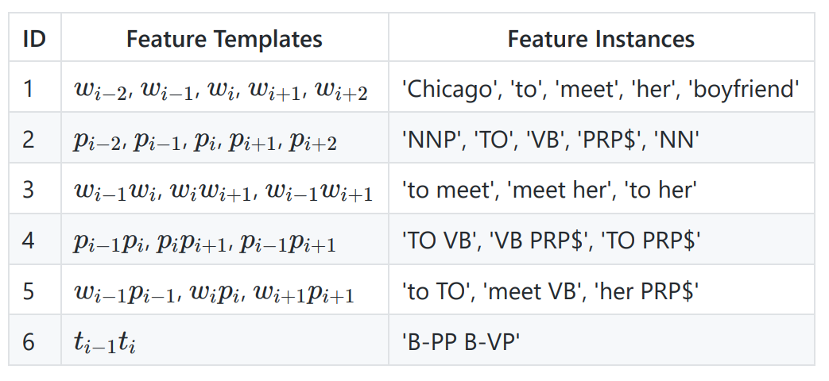
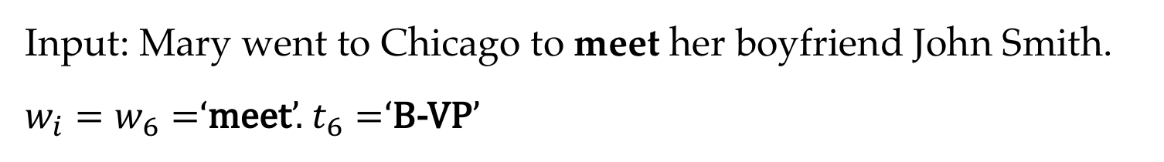
Features for syntactic chunking
Input: Mary went to Chicago to meet her boyfriend John Smith.
$w_{i}=w_{6}=$‘meet’. $t_{6}=$‘B-VP’
All combine with “B-VP”

Slide 18
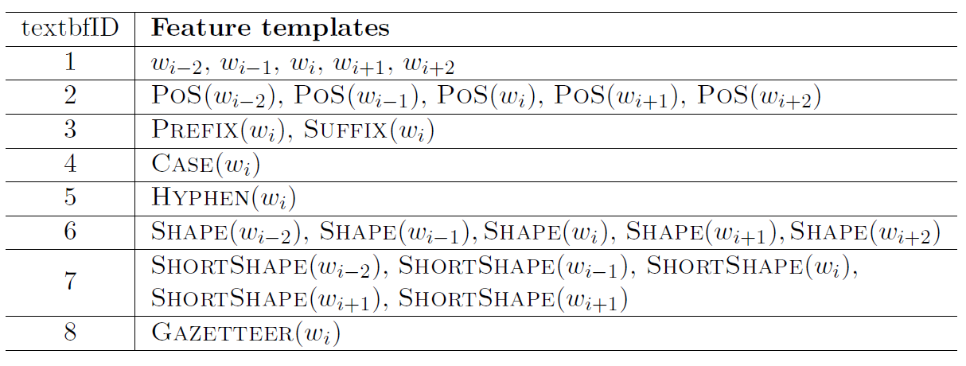
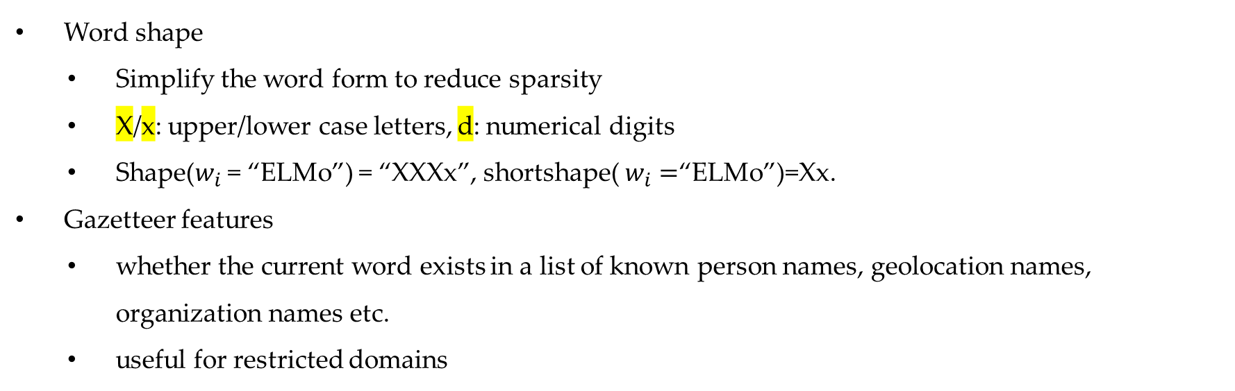
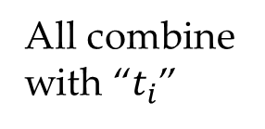
Features for NER
All combine with “$t_{i}$”
Word shape
Simplify the word form to reduce sparsity
X/x: upper/lower case letters, d: numerical digits
Shape($w_{i}$ = “ELMo”) = “XXXx”, shortshape( $w_{i}=$“ELMo”)=Xx.
Gazetteer features
whether the current word exists in a list of known person names, geolocation names, organization names etc.
useful for restricted domains

Slide 19
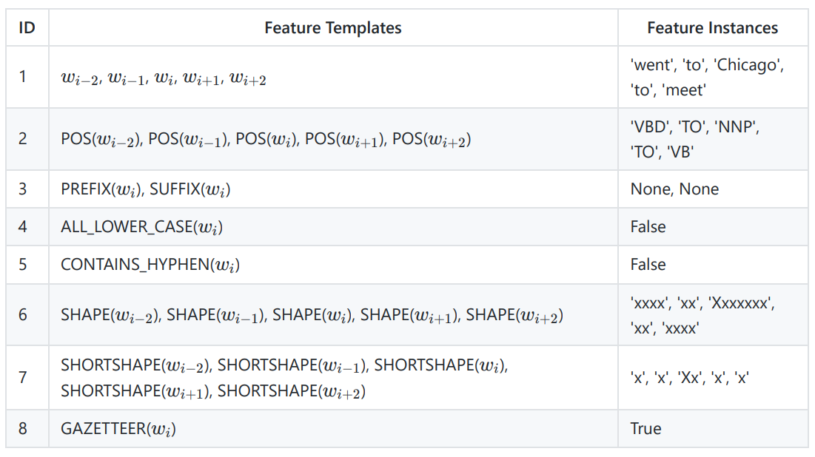
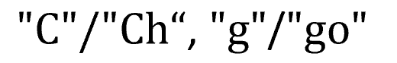
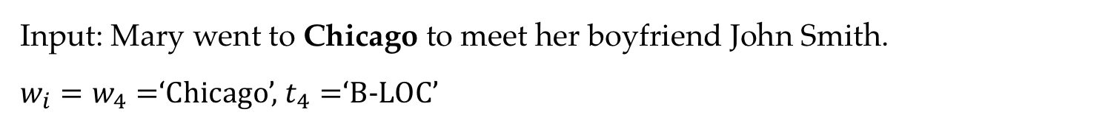
Features for NER
Input: Mary went to Chicago to meet her boyfriend John Smith.
$w_{i}=w_{4}=$‘Chicago’, $t_{4}=$‘B-LOC’
All combine with “B-LOC”

Slide 20
Contents
9.1 Sequence Segmentation
9.1.1 Evaluating Sequence Segmentation outputs
9.1.2 Sequence Labelling method for Sequence Segmentation
9.2 Discriminative Models for Sequence Segmentation
9.2.1 Word-Level Features for Word Segmentation
9.2.2 Exact Search Decoding Using Dynamic Program
9.2.3 Semi-Markov Conditional Random Fields
9.2.4 Large Margin Models
9.3 Perceptron and Beam Search
9.4 Summary

Slide 21
Problem of Segmentation by Sequence Labelling
Feature vector is the key to discriminative models.
For efficient decoding and training, sequence labelling models assume Markov properties over output label sequences
A second-order Markov model allows features to be defined over three consecutive segmentation labels
But segment level features can be beyond label n-grams. There can be words with than three characters. For example, “the previous word = 萧规曹随(to follow convention)” cannot be directly modeled.

Slide 22
Directly Modeling for Segmentation
Model sequence segmentation directly using discriminative structured predictors, which score output sequences with segment-level features
As extensions to discriminative sequence labelers for a different output structure – sequence segmentation
We consider discriminative models in this chapter.
Three aspects to discuss in detail
segment-level feature definitions
decoding
training

Slide 23
Contents
9.1 Sequence Segmentation
9.1.1 Evaluating Sequence Segmentation outputs
9.1.2 Sequence Labelling method for Sequence Segmentation
9.2 Discriminative Models for Sequence Segmentation
9.2.1 Word-Level Features for Word Segmentation
9.2.2 Exact Search Decoding Using Dynamic Program
9.2.3 Semi-Markov Conditional Random Fields
9.2.4 Large Margin Models
9.3 Perceptron and Beam Search
9.4 Summary

Slide 24
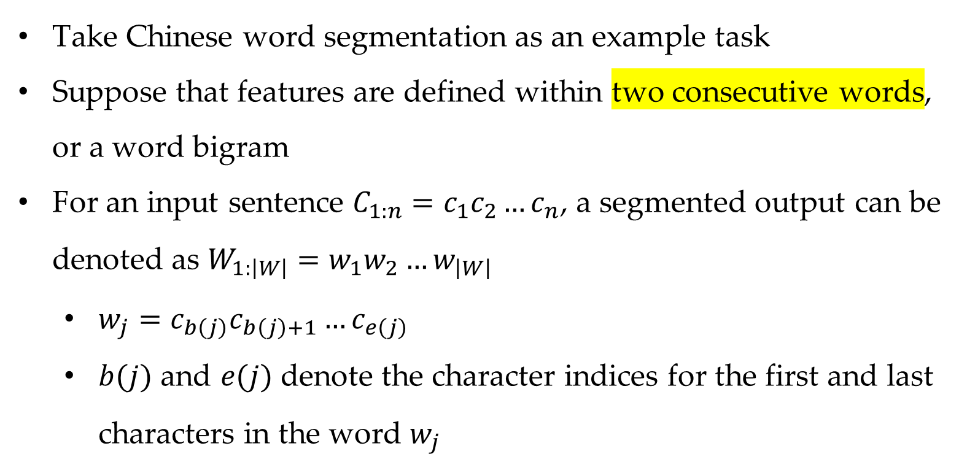
Word-Level Features for Word Segmentation
Take Chinese word segmentation as an example task
Suppose that features are defined within two consecutive words, or a word bigram
For an input sentence $C_{1:n}=c_{1}c_{2}…c_{n}$, a segmented output can be denoted as $W_{1:\left|W\right|}=w_{1}w_{2}…w_{\left|W\right|}$
$w_{j}=c_{b\left(j\right)}c_{b\left(j\right)+1}…c_{e\left(j\right)}$
$b(j)$ and $e(j)$ denote the character indices for the first and last characters in the word $w_{j}$

Slide 25
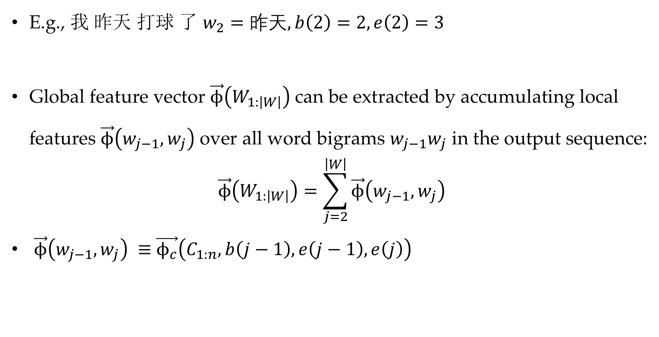
Word-Level Features for Word Segmentation
E.g., 我 昨天 打球 了 $w_{2}=昨天, b\left(2\right)=2, e\left(2\right)=3$
Global feature vector $\vec{ϕ}\left(W_{1:\left|W\right|}\right)$ can be extracted by accumulating local features $\vec{ϕ}\left(w_{j−1},w_{j}\right)$ over all word bigrams $w_{j−1}w_{j}$ in the output sequence:
$$\vec{ϕ}\left(W_{1:\left|W\right|}\right)=\sum_{j=2}^{\left|W\right|}{\vec{ϕ}\left(w_{j−1},w_{j}\right)}$$
$\vec{ϕ}\left(w_{j−1},w_{j}\right) ≡$ $\vec{ϕ_{c}}\left(C_{1:n},b\left(j−1\right),e\left(j−1\right),e\left(j\right)\right)$

Slide 26
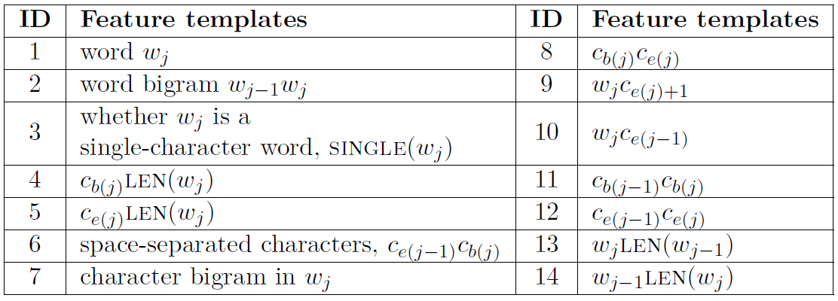
Word-Level Features for Word Segmentation

Slide 27
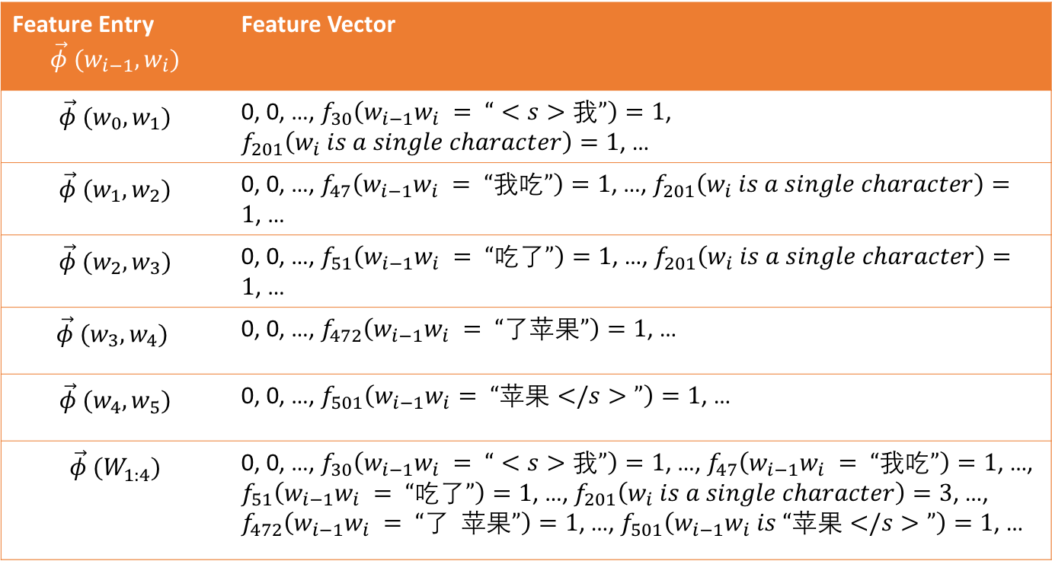
Example
Input: <s> 我 吃 了 苹果 </s>
Feature Entry $$\vec{φ} (w_{i−1},w_{i})$$ | Feature Vector
$$\vec{φ} (w_{0},w_{1})$$ | 0, 0, …, $f_{30}\left(w_{i−1}w_{i} = “<s>我”\right)=1$, $f_{201}\left(w_{i} is a single character\right)=1$, …
$$\vec{φ} (w_{1},w_{2})$$ | 0, 0, …, $f_{47}\left(w_{i−1}w_{i} = “我吃”\right)=1$, …, $f_{201}\left(w_{i} is a single character\right)=1$, …
$$\vec{φ} (w_{2},w_{3})$$ | 0, 0, …, $f_{51}\left(w_{i−1}w_{i} = “吃了”\right)=1$, …, $f_{201}\left(w_{i} is a single character\right)=1$, …
$$\vec{φ} (w_{3},w_{4})$$ | 0, 0, …, $f_{472}\left(w_{i−1}w_{i} = “了苹果”\right)=1$, …
$$\vec{φ} (w_{4},w_{5})$$ | 0, 0, …, $f_{501}\left(w_{i−1}w_{i}= “苹果</s>”\right)=1$, …
$$\vec{φ} (W_{1:4}^{})$$ | 0, 0, …, $f_{30}\left(w_{i−1}w_{i} = “<s>我”\right)=1$, …, $f_{47}\left(w_{i−1}w_{i} = “我吃”\right)=1$, …, $f_{51}\left(w_{i−1}w_{i} = “吃了”\right)=1$, …,$f_{201}\left(w_{i} is a single character\right)=3$, …, $f_{472}\left(w_{i−1}w_{i} = “了 苹果”\right)=1$, …, $f_{501}\left(w_{i−1}w_{i} is “苹果</s>”\right)=1$, …

Slide 28
Contents
9.1 Sequence Segmentation
9.1.1 Evaluating Sequence Segmentation outputs
9.1.2 Sequence Labelling method for Sequence Segmentation
9.2 Discriminative Models for Sequence Segmentation
9.2.1 Word-Level Features for Word Segmentation
9.2.2 Exact Search Decoding Using Dynamic Program
9.2.3 Semi-Markov Conditional Random Fields
9.2.4 Large Margin Models
9.3 Perceptron and Beam Search
9.4 Summary

Slide 29
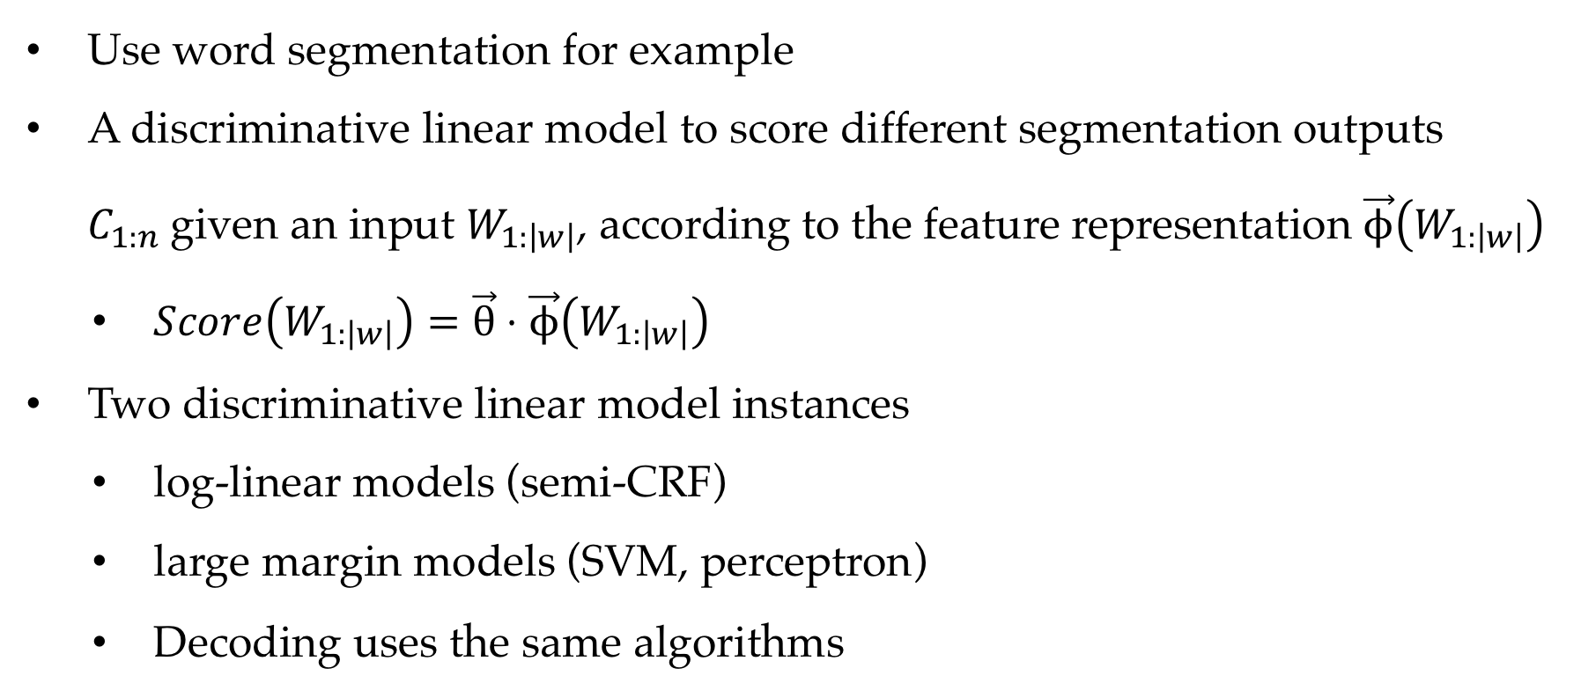
Discriminative linear models for sequence segmentation
Use word segmentation for example
A discriminative linear model to score different segmentation outputs $C_{1:n}$given an input $W_{1:\left|w\right|}$, according to the feature representation $\vec{ϕ}\left(W_{1:\left|w\right|}\right)$
$Score\left(W_{1:\left|w\right|}\right)=\vec{θ}⋅\vec{ϕ}\left(W_{1:\left|w\right|}\right)$
Two discriminative linear model instances
log-linear models (semi-CRF)
large margin models (SVM, perceptron)
Decoding uses the same algorithms

Slide 30
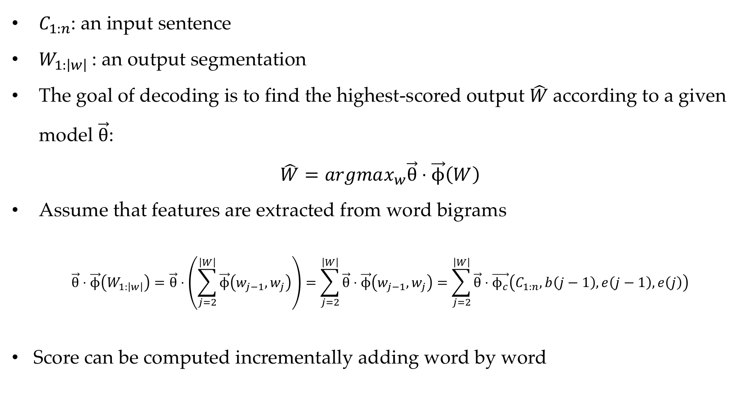
Decoding
$C_{1:n}$: an input sentence
$W_{1:\left|w\right|}$: an output segmentation
The goal of decoding is to find the highest-scored output $\hat{W}$according to a given model $\vec{θ}$:
$$\hat{W}=argmax_{w}\vec{θ}⋅\vec{ϕ}\left(W\right)$$
Assume that features are extracted from word bigrams
$$\vec{θ}⋅\vec{ϕ}\left(W_{1:\left|w\right|}\right)=\vec{θ}⋅\left(\sum_{j=2}^{\left|W\right|}{\vec{ϕ}\left(w_{j−1},w_{j}\right)}\right)=\sum_{j=2}^{\left|W\right|}{\vec{θ}}⋅\vec{ϕ}\left(w_{j−1},w_{j}\right)=\sum_{j=2}^{\left|W\right|}{\vec{θ}}⋅\vec{ϕ_{c}}\left(C_{1:n},b\left(j−1\right),e\left(j−1\right),e\left(j\right)\right)$$
Score can be computed incrementally adding word by word

Slide 31
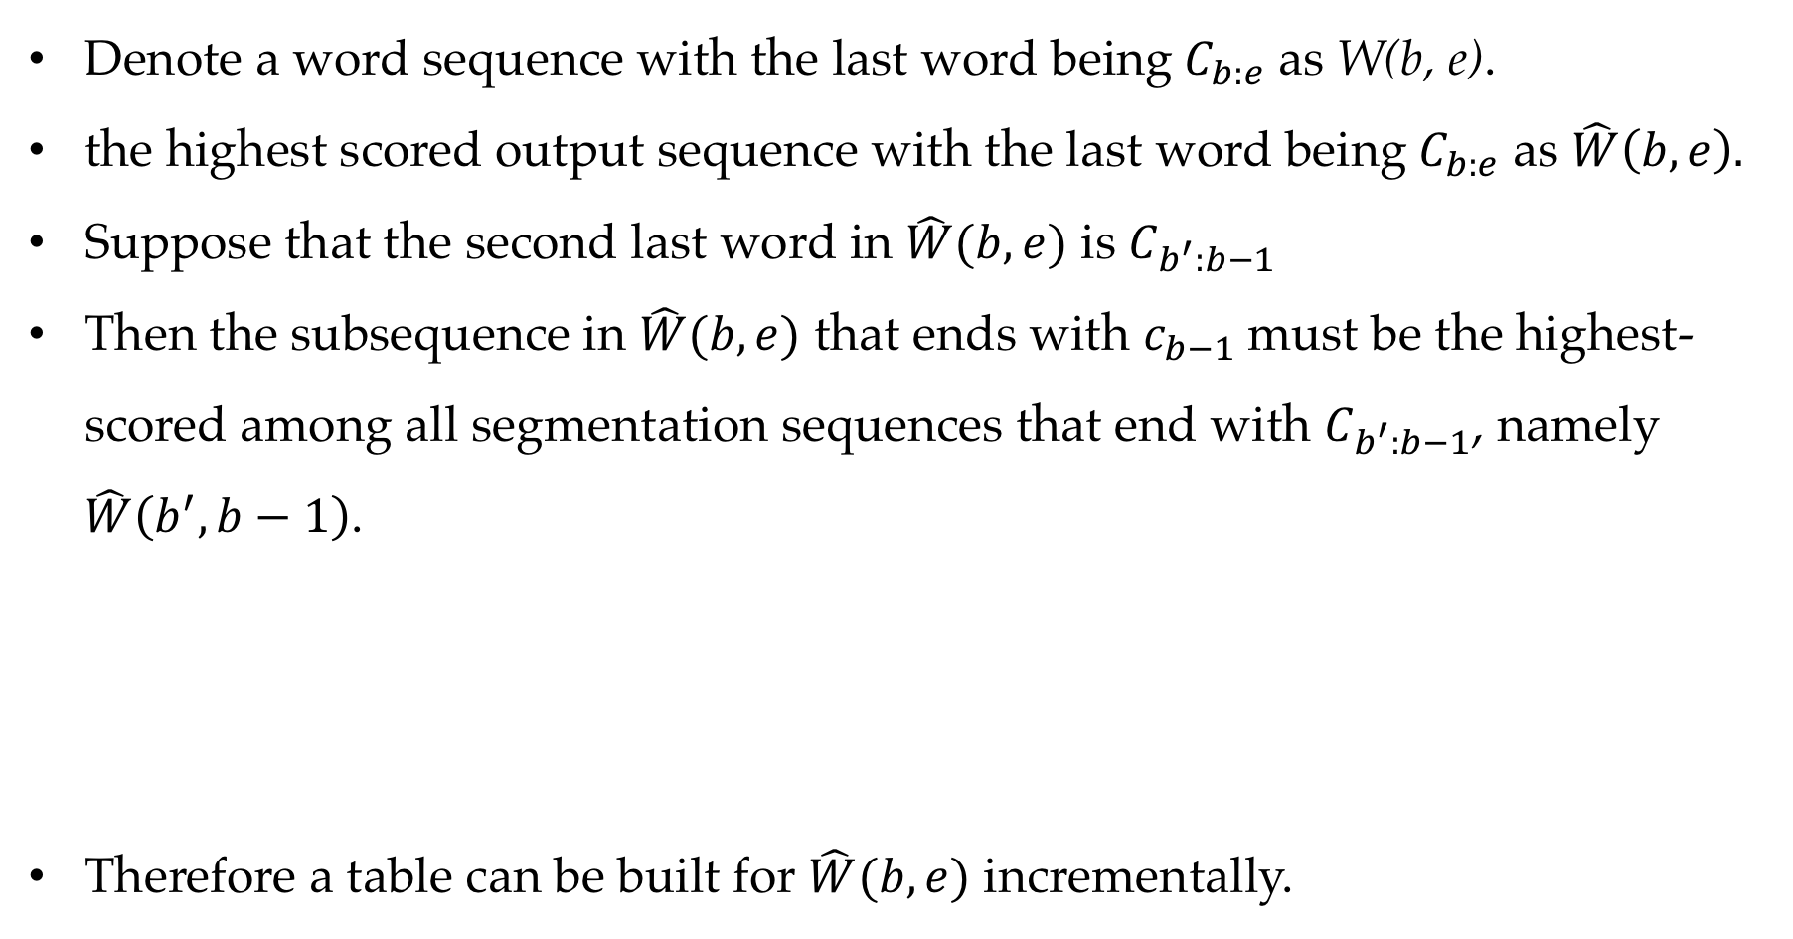
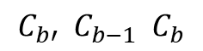
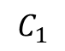
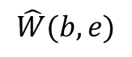
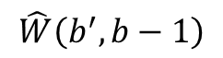
Decoding
Denote a word sequence with the last word being$C_{b:e}$ as W(b, e).
the highest scored output sequence with the last word being$C_{b:e}$ as $\hat{W}\left(b,e\right).$
Suppose that the second last word in $\hat{W}(b,e)$ is $C_{b^{′}:b−1}$
Then the subsequence in $\hat{W}(b,e)$ that ends with $c_{b−1}$must be the highest-scored among all segmentation sequences that end with $C_{b^{′}:b−1}$, namely $\hat{W}\left(b^{′},b−1\right)$.
Therefore a table can be built for $\hat{W}(b,e)$ incrementally.
$$C_{1}$$
$$C_{e}$$
$$C_{b′} C_{b−1} C_{b}$$
$$\hat{W}\left(b^{′},b−1\right)$$
$$\hat{W}(b,e)$$
Notes:
加入表格

Slide 32
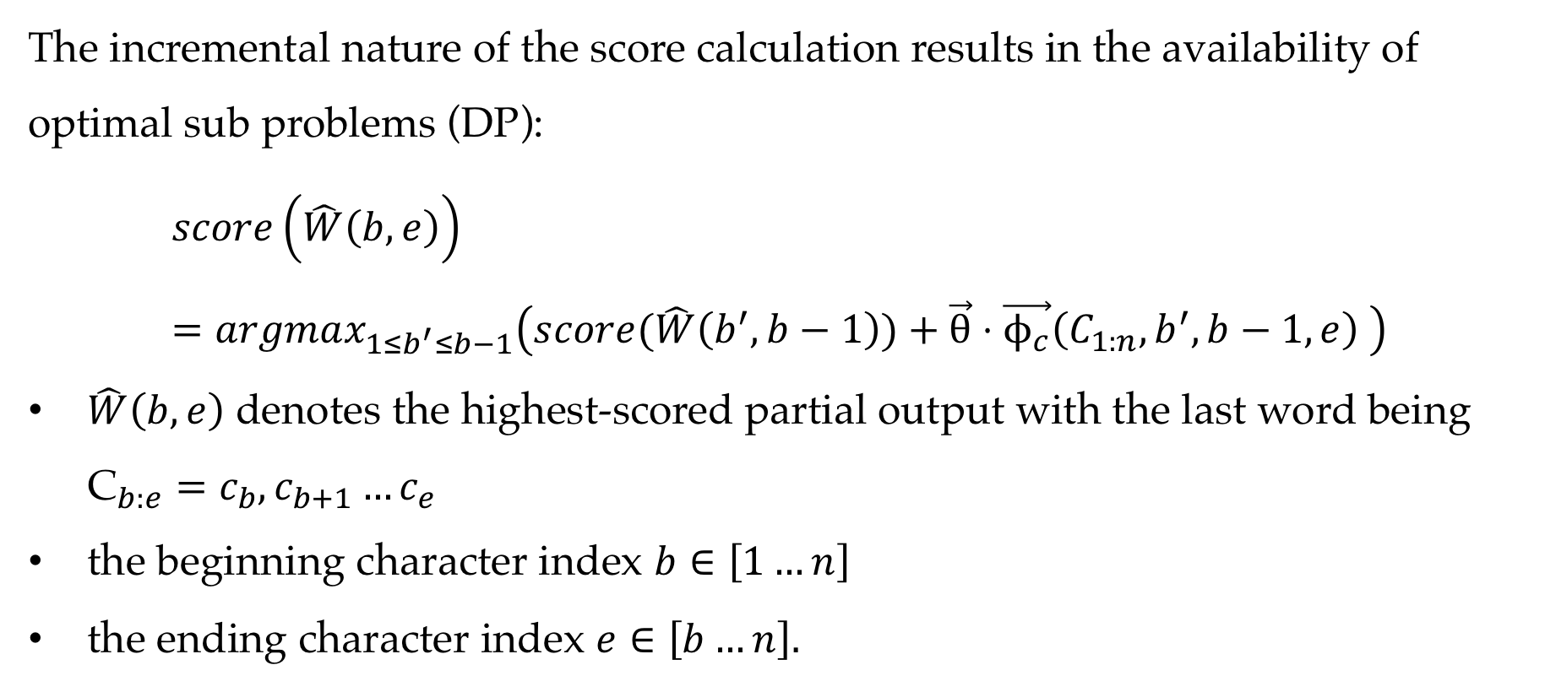
Decoding
The incremental nature of the score calculation results in the availability of optimal sub problems (DP):
$$score\left(\hat{W}\left(b,e\right)\right)=argmax_{1≤b^{′}≤b−1}\left(score(\hat{W}\left(b^{′},b−1\right))+\vec{θ}⋅\vec{ϕ_{c}}\left(C_{1:n},b^{′},b−1,e\right) \right)$$
$\hat{W}\left(b,e\right)$ denotes the highest-scored partial output with the last word being ${\text{C}}_{b:e}=c_{b},c_{b+1}…c_{e}$
the beginning character index $b∈\left[1…n\right]$
the ending character index $e∈\left[b…n\right].$
Notes:
加入表格

Slide 33
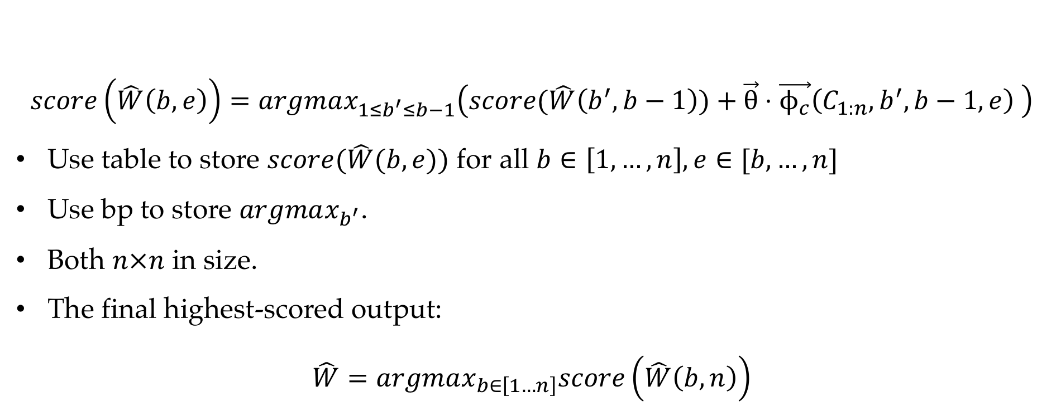
Decoding
$$score\left(\hat{W}\left(b,e\right)\right)=argmax_{1≤b^{′}≤b−1}\left(score(\hat{W}\left(b^{′},b−1\right))+\vec{θ}⋅\vec{ϕ_{c}}\left(C_{1:n},b^{′},b−1,e\right) \right)$$
Use table to store $score(\hat{W}(b,e))$ for all $b∈\left[1,…,n\right],e∈[b,…,n]$
Use bp to store $argmax_{b^{′}}$.
Both $n×n$ in size.
The final highest-scored output:
$$\hat{W}=argmax_{b∈\left[1…n\right]}score\left(\hat{W}\left(b,n\right)\right)$$
Notes:
加入表格

Slide 34
Decoding
 |  |  | 下
 |  | 天
 | 前 | 前天
以 | 以前 | 以前天
……
4
3
2
1
1
2
3
4
……
以_前

Slide 35
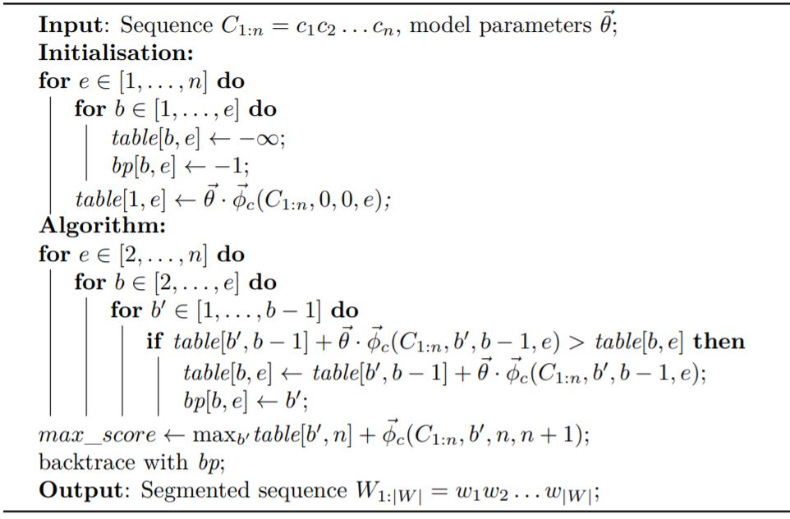
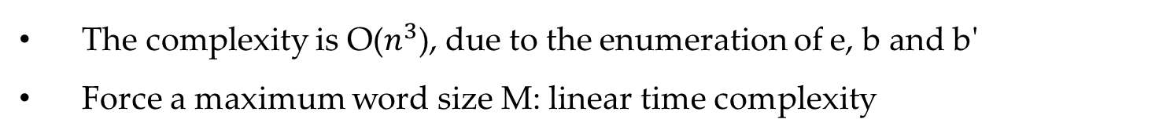
Decoding
The complexity is O($n^{3}$), due to the enumeration of e, b and b'
Force a maximum word size M: linear time complexity

Slide 36
Contents
9.1 Sequence Segmentation
9.1.1 Evaluating Sequence Segmentation outputs
9.1.2 Sequence Labelling method for Sequence Segmentation
9.2 Discriminative Models for Sequence Segmentation
9.2.1 Word-Level Features for Word Segmentation
9.2.2 Exact Search Decoding Using Dynamic Program
9.2.3 Semi-Markov Conditional Random Fields
9.2.4 Large Margin Models
9.3 Perceptron and Beam Search
9.4 Summary

Slide 37
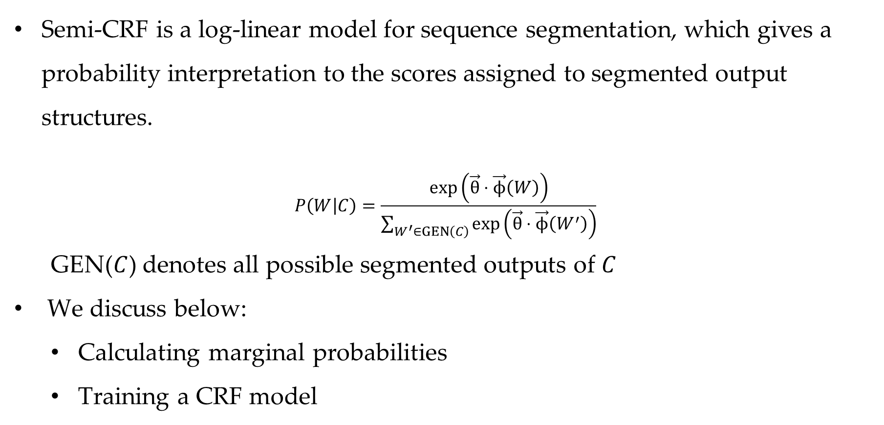
Semi-Markov Conditional Random Fields
Semi-CRF is a log-linear model for sequence segmentation, which gives a probability interpretation to the scores assigned to segmented output structures.
$$P\left(W | C\right)=\frac{\exp\left(\vec{θ}⋅\vec{ϕ}\left(W\right)\right)}{\sum_{W^{′}∈GEN\left(C\right)}{\exp\left(\vec{θ}⋅\vec{ϕ}\left(W^{′}\right)\right)}}$$
GEN($C$) denotes all possible segmented outputs of $C$
We discuss below:
Calculating marginal probabilities
Training a CRF model

Slide 38
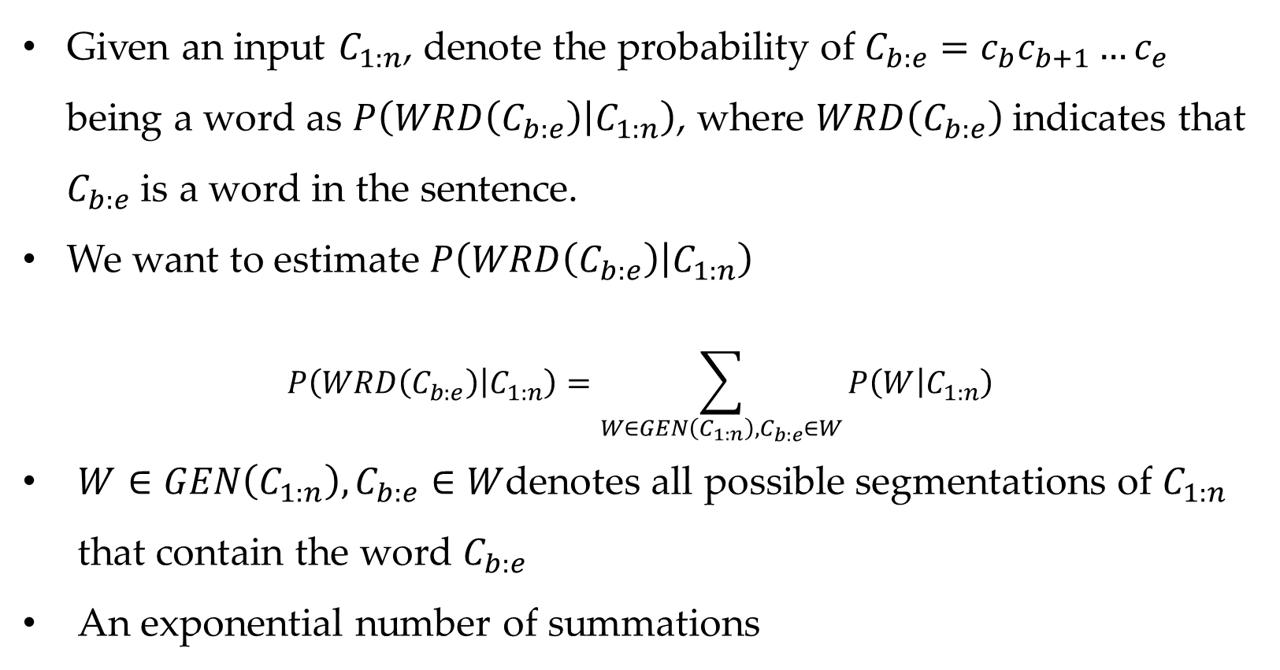
Calculating Marginal Probabilities
Given an input $C_{1:n}$, denote the probability of $C_{b:e}=c_{b}c_{b+1}…c_{e}$ being a word as $P\left(WRD\left(C_{b:e}\right) | C_{1:n}\right)$, where $WRD\left(C_{b:e}\right)$indicates that $C_{b:e}$ is a word in the sentence.
We want to estimate $P\left(WRD\left(C_{b:e}\right) | C_{1:n}\right)$
$$P\left(WRD\left(C_{b:e}\right) | C_{1:n}\right)=\sum_{W∈GEN\left(C_{1:n}\right),C_{b:e}∈W}{P\left(W | C_{1:n}\right)}$$
$W∈GEN\left(C_{1:n}\right),C_{b:e}∈W$denotes all possible segmentations of $C_{1:n}$ that contain the word $C_{b:e}$
An exponential number of summations

Slide 39
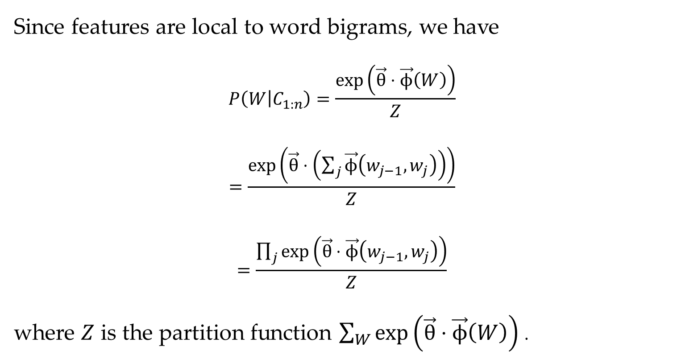
Calculating Marginal Probabilities
Since features are local to word bigrams, we have
$$P\left(W | C_{1:n}\right)=\frac{\exp\left(\vec{θ}⋅\vec{ϕ}\left(W\right)\right)}{Z}$$
$$=\frac{\exp\left(\vec{θ}⋅\left(\sum_{j}{\vec{ϕ}\left(w_{j−1},w_{j}\right)}\right)\right)}{Z}$$
$$=\frac{\prod_{j}{\exp\left(\vec{θ}⋅\vec{ϕ}\left(w_{j−1},w_{j}\right)\right)}}{Z}$$
where $Z$ is the partition function $\sum_{W}{\exp\left(\vec{θ}⋅\vec{ϕ}\left(W\right)\right)}$.

Slide 40
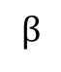
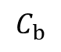
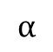
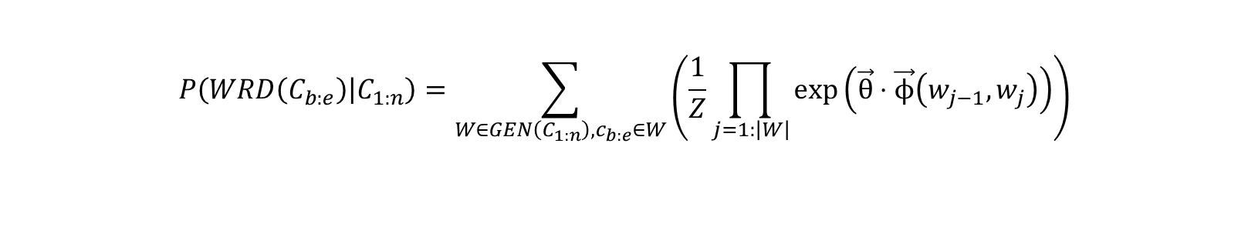
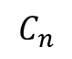
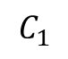
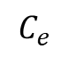
Calculating Marginal Probabilities
$$P\left(WRD\left(C_{b:e}\right) | C_{1:n}\right)=\sum_{W∈GEN\left(C_{1:n}\right),c_{b:e}∈W}{\left(\frac{1}{Z}\prod_{j=1:\left|W\right|}{\exp\left(\vec{θ}⋅\vec{ϕ}\left(w_{j−1},w_{j}\right)\right)}\right)}$$
$$C_{1}$$
$$C_{b}$$
$$C_{e}$$
$$C_{n}$$
$$α$$
$$β$$

Slide 41




Calculating Marginal Probabilities
$$⟹α(b,e)$$
$$⟹β(b,e)$$
For $W^{l}{=w_{1}^{l}, w_{2}^{l},…,w_{\left|W^{l}\right|}^{l}, w}_{|W^{l}|}^{l}=C_{b:e}$
For $W^{r}$ $=w_{1}^{r}, w_{2}^{r},…,w_{\left|W^{r}\right|}^{r}$, $w_{1}^{r}=C_{b:e}$
cuts the full summation into the product of two components, with the splitting point at $(b,e)$.

Slide 42




Calculating Marginal Probabilities
$$β$$
$C_{b:e}=C_{3:4}$
It's similar to Forward-Backward Algorithm in CRF

Slide 43

Forward Algorithm for semi-CRF
For the first component
$α\left(b^{′},e^{′}\right)=\sum_{W^{l}∈GEN\left(C_{1:e^{′}}\right),C_{b^{′}:e^{′}}∈W^{l}}{\prod_{j=1}^{\left|W^{l}\right|}{\exp\left(\vec{θ}⋅\vec{ϕ}\left(w_{j−1}^{l},w_{j}^{l}\right)\right)}} = \sum_{b^{′′}∈\left[1…b^{′}−1\right] }{\sum_{w^{e}∈GEN\left(C_{1:e^{′}}\right), C_{b^{′′}:b^{′}−1}∈w^{e}}{\prod_{j=1}^{\left|w^{e}\right|}{\exp\left(\hat{θ}∙\hat{φ}\left(w_{j−1}^{l}, w_{j}^{l}=C_{b^{′′},b^{′}−1}\right)\right)}}}∙exp\left(\hat{θ}∙\hat{φ}\left(C_{b^{′′},b^{′}−1}, C_{b^{′},e}\right)\right)$
$α\left(b^{′},e^{′}\right)$can be calculated incrementally by summing up relevant values regarding $α\left(b^{′′},b^{′}−1\right)$ for all valid $b^{′′}$:
$$α\left(b^{′},e^{′}\right)=\sum_{b^{′′}∈\left[1…b^{′}−1\right]}{\left(α\left(b^{′′},b^{′}−1\right)⋅\exp\left(\vec{θ}⋅\vec{ϕ_{c}}\left(C_{1:e},b^{′′},b^{′}−1,e^{′}\right)\right)\right)}$$
where $b^{′}∈\left[1,…,e\right],e^{′}∈\left[b^{′},…,e\right]$
Notes:
Intuitive graph illustration

Slide 44




Forward Algorithm for semi-CRF
$${α }_{b^{′},e^{′}}$$
$$α_{b^{′′},b^{′}−1}$$
$$b^{′′}∈[1,…,b^{′}−1]$$
$$α\left(b^{′},e^{′}\right)=\sum_{b^{′′}∈\left[1…b^{′}−1\right]}{\left(α\left(b^{′′},b^{′}−1\right)⋅\exp\left(\vec{θ}⋅\vec{ϕ_{c}}\left(C_{1:e},b^{′′},b^{′}−1,e^{′}\right)\right)\right)}$$
where $b^{′}∈\left[1,…,e\right],e^{′}∈\left[b^{′},…,e\right]$
Notes:
Intuitive graph illustration

Slide 45


Forward Algorithm for semi-CRF
Starting from boundary values
$α\left(1,e^{′}\right)=\exp\left(\vec{θ}⋅\vec{ϕ_{c}}\left(C_{1:e},0,0,e^{′}\right)\right)$ for $e^{′}∈\left[1,…,e\right]$,

Slide 46

Backward Algorithm for semi-CRF
For the second component
$$β\left(b^{′},e^{′}\right)=\sum_{W^{r}∈GEN\left(C_{b^{′}:n}\right),C_{b^{′}:e^{′}}∈W^{r}}{\prod_{j=1}^{\left|W^{r}\right|−1}{\exp\left(\vec{θ}⋅\vec{ϕ}\left(w_{j}^{r},w_{j+1}^{r}\right)\right)}}$$
$β\left(b^{′},e^{′}\right)$ can be calculated incrementally by summing up relevant values from all $β\left(e^{′}+1,e^{′′}\right)$, where $e^{′′}∈\left[e^{′}+1,…,n\right]$
$$β\left(b^{′},e^{′}\right)=\sum_{e^{′′}∈\left[e^{′}+1,…,n\right]}{\left(β\left(e^{′}+1,e^{′′}\right)⋅\exp\left(\vec{θ}⋅\vec{ϕ_{c}}\left(C_{e+1:n},b^{′},e^{′},e^{′′}\right)\right)\right)}$$
where $b^{′}∈\left[e+1,…,n\right],e^{′}∈\left[e+1,…,n\right]$.

Slide 47


Backward Algorithm for semi-CRF
Starting from boundary values
$β\left(b^{′},n\right)=1$

Slide 48

Calculating Marginal Probabilities
After obtaining $α\left(b^{′},e^{′}\right)$ and $β\left(b^{′},e^{′}\right)$ values, $P\left(WRD\left(C_{b:e} | C_{1:n}\right)\right)$ can be calculated as:
$$\frac{1}{Z}α\left(b,e\right)β\left(b,e\right)$$

Slide 49

Partition function for semi-CRF
Partition Function
$$Z=\sum_{w}{exp⁡(\hat{θ}∙\hat{φ}(w))}$$
Can use a dynamic program, similar to the decoding algorithm, but with $max$ being replaced by $sum$.

Slide 50

Partition function for semi-CRF
Log sum exp trick can be used to avoid numeric overflow.

Slide 51
Contents
9.1 Sequence Segmentation
9.1.1 Evaluating Sequence Segmentation outputs
9.1.2 Sequence Labelling method for Sequence Segmentation
9.2 Discriminative Models for Sequence Segmentation
9.2.1 Word-Level Features for Word Segmentation
9.2.2 Exact Search Decoding Using Dynamic Program
9.2.3 Semi-Markov Conditional Random Fields
9.2.4 Large Margin Models
9.3 Perceptron and Beam Search
9.4 Summary

Slide 52

Training semi-CRF
Given a set of training data $D=\{\left(C_{i},W_{i}\right)\}{\left.​\right|}_{i=1}^{n}$, where $C_{i}$ is a sentence and $W_{i}$ is its corresponding gold-standard segmentation, the semi-CRF training objective is to maximize the log-likelihood of $D$:
$\vec{\hat{θ}}=argmax_{\vec{θ}}\log{P}\left(D\right)$
$=argmax_{\vec{θ}}\sum_{i}{\log{P}\left(W_{i} | C_{i}\right)}$
$=argmax_{\vec{θ}}\sum_{i}{\log{\frac{\exp\left(\vec{θ}⋅\vec{ϕ}\left(W_{i},C_{i}\right)\right)}{\sum_{W^{′}∈GEN\left(W\right)}{\exp\left(\vec{θ}⋅\vec{ϕ}\left(W^{′},C_{i}\right)\right)}}}}$
$=argmax_{\vec{θ}}\sum_{i}{\left(\vec{θ}⋅\vec{ϕ}\left(W_{i},C_{i}\right)−\log\left(\sum_{W^{′}∈GEN\left(W_{i}\right)}{\exp\left(\vec{θ}⋅\vec{ϕ}\left(W^{′},C_{i}\right)\right)}\right)\right)}$

Slide 53
Local gradient

Slide 54

Local gradient
For each training example, the local gradient with respect to $\vec{θ}$ is:
$\vec{ϕ}\left(W_{i},C_{i}\right)−\frac{\sum_{W^{′}}{\exp\left(\vec{θ}⋅\vec{ϕ}\left(W^{′},C_{i}\right)\right)⋅\vec{ϕ}\left(W^{′},C_{i}\right)}}{\sum_{W^{′′}}{\exp\left(\vec{θ}⋅\vec{ϕ}\left(W^{′′},C_{i}\right)\right)}}$
$=\vec{ϕ}\left(W_{i},C_{i}\right)−\sum_{W^{′}}{P\left(W^{′} | C_{i}\right)\vec{ϕ}\left(W^{′},C_{i}\right)},\left(\text{definition} \text{of} P\left(W^{′} | C_{i}\right)\right)$
The major challenge is the summation of exponential possible outputs.

Slide 55

Local gradient
Similar to CRF, rely on feature locality.
Taking word segmentation for example:
$$\sum_{W^{′}}{P\left(W^{′} | C_{i}\right)\vec{ϕ}\left(W^{′},C_{i}\right)}=\sum_{W^{′}∈GEN\left(C_{i}\right)}{P\left(W^{′} | C_{i}\right)\left(\sum_{j=1}^{\left|W^{′}\right|}{\vec{ϕ}\left(w_{j−1},w_{j}\right)}\right)}$$
$$=E_{W^{′}∼P\left(W^{′} | C_{i}\right)}\left(\sum_{j=1}^{\left|W^{′}\right|}{\vec{ϕ}\left(w_{j−1},w_{j}\right)}\right)$$

Slide 56

Solution: feature locality
We can rewrite $\sum_{W^{′}}{P\left(W^{′} | C_{i}\right)}$ as:
$E_{W^{′}∼P\left(W^{′} | C_{i}\right)}\left(\sum_{j=1}^{\left|W^{′}\right|}{\vec{ϕ}\left(w_{j−1},w_{j}\right)}\right)$
$=E_{W^{′}∼P\left(W^{′} | C_{i}\right)}\left(\sum_{C_{b^{′}:b−1}∈W^{′},C_{b:e}∈W^{′}}{\vec{ϕ_{c}}\left(C_{i},b^{′},b−1,e\right)}\right)$
$$=\sum_{b^{′},b,e}{E_{C_{b^{′}:b−1 }C_{b:e}∼P(IsBigram(b^{′},b−1,e)|C_{i})}\vec{ϕ_{c}}\left(C_{i},b^{′},b−1,e\right)}$$
GENBIGRAM represents the set of all bigrams in all possible segmentations of $C_{i}$

Slide 57

Solution: feature locality
Equal to the sum of the feature vectors weighed by the marginal probability of the bigram: $P(IsBigram(b^{′},b−1,e)|C_{i})\vec{ϕ_{c}}\left(C_{i},b^{′},b−1,e\right)$
Thus, the task boils down to the calculation of the marginal probabilities $P\left(BIGRAM\left(b^{′},b−1,e\right) | C_{i}\right)$ efficiently for all valid values of $b^{′}$, $b$ and $e$

Slide 58
Solution: feature locality

Slide 59


Solution: feature locality
For $W^{l},$ we have $W_{\left|W^{l}−1\right|}^{l}=C_{b^{′}:b−1},$ and for $W^{r}$, we have $w_{1}^{r}=C_{b:e}$

Slide 60

Solution: feature locality
$P\left(BIGRAM\left(b^{′},b−1,e\right) | C_{i}\right)$ can be computed efficiently using Forward-Backward technique
$$P\left(BIGRAM\left(b^{′},b−1,e\right) | C_{i}\right)=\frac{α\left(b^{′},b−1\right)β\left(b,e\right)\exp\left(\vec{θ}⋅\vec{ϕ_{c}}\left(C_{i},b^{′},b−1,e\right)\right)}{Z}$$

Slide 61

Forward Backward Algorithm for training semi-CRF

Slide 62

Forward Backward Algorithm for training semi-CRF
Partition Function
$$Z=\sum_{w}{exp⁡(\hat{θ}∙\hat{φ}(w))}$$
Can use a dynamic program, similar to the decoding algorithm, but with $max$ being replaced by $sum$.

Slide 63
Partition function for semi-CRF
Log sum exp trick can be used to avoid numeric overflow.

Slide 64
Contents
9.1 Sequence Segmentation
9.1.1 Evaluating Sequence Segmentation outputs
9.1.2 Sequence Labelling method for Sequence Segmentation
9.2 Discriminative Models for Sequence Segmentation
9.2.1 Word-Level Features for Word Segmentation
9.2.2 Exact Search Decoding Using Dynamic Program
9.2.3 Semi-Markov Conditional Random Fields
9.2.4 Large Margin Models
9.3 Perceptron and Beam Search
9.4 Summary

Slide 65

Large Margin Models
Scoring
$score\left(S\right)=\vec{θ}⋅\vec{ϕ}\left(S\right)$
Decoding: same as semi-CRF

Slide 66

Large Margin Models
Scoring
$score\left(S\right)=\vec{θ}⋅\vec{ϕ}\left(S\right)$
Decoding: same as semi-CRF
Training
largely the same as those for sequence labelling
structure perceptron $\sum_{i=1}^{N}{\max\left(0,\max_{S^{′}}\left(\vec{θ}⋅\vec{ϕ}\left(S^{′}\right)\right)−\vec{θ}⋅\vec{ϕ}\left(S_{i}\right)\right)}$
structured SVM
$$\frac{1}{2}{\left|\left|\vec{θ}\right|\right|}^{2}+C\left(\sum_{i=1}^{N}{\max\left(0,1−\vec{θ}⋅\vec{ϕ}\left(S_{i}\right)+\max_{S^{′}≠S_{i}}\left(\vec{θ}⋅\vec{ϕ}\left(S^{′}\right)\right)\right)}\right)$$

Slide 67

Large Margin Models

Slide 68
Contents
9.1 Sequence Segmentation
9.1.1 Evaluating Sequence Segmentation outputs
9.1.2 Sequence Labelling method for Sequence Segmentation
9.2 Discriminative Models for Sequence Segmentation
9.2.1 Word-Level Features for Word Segmentation
9.2.2 Exact Search Decoding Using Dynamic Program
9.2.3 Semi-Markov Conditional Random Fields
9.2.4 Large Margin Models
9.3 Perceptron and Beam Search
9.4 Summary

Slide 69

Segment-level features
Pros
offer a wider context range
a direct source of information about the output structures
Cons
feature sparsity
For syntactic chunking, a possible noun phrase can span over tens of words.
decoding inefficiency
using segment bigram feature: O($n^{3}$)
using segment trigram features: O($n^{4}$)

Slide 70

Segment-level features
Pros
offer a wider context range
a direct source of information about the output structures
Cons
feature sparsity
For syntactic chunking, a possible noun phrase can span over tens of words.
decoding inefficiency
using segment bigram feature: O($n^{3}$)
using segment trigram features: O($n^{4}$)

Slide 71
Solution: beam search
Model can use arbitrary features without Markov assumptions
Inexact search to accommodate feature context
Incrementally processes the input sequence from left to right, building the output structure in linear time.
Tradeoff between optimality and efficiency.

Slide 72

Beam Search Decoding
Given an input sentence $W_{1:n}$, the algorithm incrementally builds partial output candidates $T_{1:i}$ from left to right, using an agenda to maintain the $k$ highest scored partial output at each step.
Each candidate is a partial output $T_{1:i}$.
Starting from an initial agenda with an empty sequence
At each step, enumerate all possible local structures concerning the current word to generate new partial output candidates
Score each candidate and leave top-k candidates for next step
Repeats until the end of the sentence, the top-1 left is taken for output

Slide 73


An Example of Beam Search
$C_{1:5}$ = 西 班 牙 足 球

Slide 74

Beam Search Decoding Algorithm

Slide 75

Relaxing feature locality constraints
At each step, we should score partial outputs from the beginning of the sentence until the current word being processed
At the $i$-th incremental step, the feature vector for the partial output $T_{1:i}$ is built incrementally from the previous step:
$$\vec{ϕ}\left(W_{1:n},T_{1:i}\right)=\vec{ϕ}\left(W_{1:n},T_{1:i−1}\right)+\vec{ϕ_{Δ}}\left(W_{1:n},T_{1:i−1},t_{i}\right)$$
$\vec{ϕ_{Δ}}\left(W_{1:n},T_{1:i−1},t_{i}\right)$ indicates the incremental feature vector that consists of the partial structures concerning $t_{i}$
Differences from the incremental feature for sequence labeling $\vec{ϕ}\left(W_{1:n},T_{I−k:i−1},t_{i}\right)$
no Markov restriction on the label context

Slide 76
Contents
9.1 Sequence Segmentation
9.1.1 Evaluating Sequence Segmentation outputs
9.1.2 Sequence Labelling method for Sequence Segmentation
9.2 Discriminative Models for Sequence Segmentation
9.2.1 Word-Level Features for Word Segmentation
9.2.2 Exact Search Decoding Using Dynamic Program
9.2.3 Semi-Markov Conditional Random Fields
9.2.4 Large Margin Models
9.3 Perceptron and Beam Search
9.4 Summary

Slide 77
Beam Search
Problems
highest model score is not guaranteed to be found by the decoder.
Solution
adjust the training objective into the minimization of search errors.
Merge model error and search error into one single objective.

Slide 78

Perceptron Training for Guiding Beam-search Decoding
Basic idea
Use the current model parameter $\vec{θ}$to decode training instances by beam search
If the model makes a mistake, update $\vec{θ}$
Two types of updates
At the $i$-th step, the gold local structure sequence $G_{1:i}$ falls out of agenda/beam
The highest-scored output $\hat{T_{1:n}}$has a higher score compared with $G_{1:n}$
Update method
Standard perceptron algorithm
Mistake 1: $G_{1:i}$ (positive example), $\hat{T_{1:i}}$ (negative example)
Mistake 2: $G_{1:n}$ (positive example), $\hat{T_{1:n}}$ (negative example)

Slide 79

Beam Search Training Algorithm

Slide 80

Beam Search Training Algorithm

Slide 81
Contents
9.1 Sequence Segmentation
9.1.1 Evaluating Sequence Segmentation outputs
9.1.2 Sequence Labelling method for Sequence Segmentation
9.2 Discriminative Models for Sequence Segmentation
9.2.1 Word-Level Features for Word Segmentation
9.2.2 Exact Search Decoding Using Dynamic Program
9.2.3 Semi-Markov Conditional Random Fields
9.2.4 Large Margin Models
9.3 Perceptron and Beam Search
9.4 Summary

Slide 82
Summary
Sequence segmentation using Sequence Labeling
Discriminative models for directly solving sequence segmentation tasks
Semi-Markov Conditional Random Fields
A learning guided beam search framework using perceptron training

